Slide 1
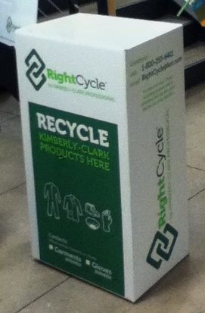
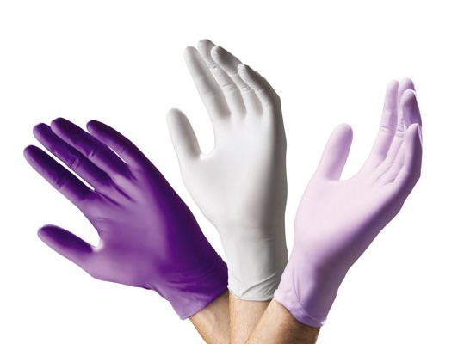
For any questions, contact hazwaste@ucsc.edu
Announcing the UCSC Green Labs
Kimberly-Clark Nitrile Glove Recycling Program
Green Labs Glove Recycling Program Website
Here’s How It Works
Start collecting Kimberly-Clark (KC) nitrile gloves in a container in your lab (plastic liner allowed).
Drop off the gloves at the KC Nitrile Glove Recycling
Box in your building:
Physical Sciences Building - room 101
Sinsheimer – room 137
Biomed - room 208
Jack Baskin Engineering Building - room 202
Anthropology - SSI 439
Earth & Marine Sciences - 2nd floor C block by e-waste collection
Long Marine Lab - in the mail room
2300 Delaware – room C145
Recyclable Kimberly-Clark Gloves Accepted (CruzBuy)
Purple Nitrile
Sterling Nitrile
Kimberly-Clark Sterling Gray Nitrile – 3.5 mil
Lavender Nitrile
Kimberly-Clark Lavender Nitrile – 2 mil
12” Cuff = 53137 – 53141 (100 Gloves/Pack)
9.5” Cuff = 50705 – 50709 (200 Gloves/Pack)
9.5” Cuff = 52816 – 52820 (250 Gloves/Pack)
12” Cuff = 55090, 50601 – 50604 (50 Gloves/Pack)
9.5” Cuff = 55080 – 55084 (100 Gloves/Pack)
Kimberly-Clark Purple Nitrile – 6 mil

Slide 2
For assistance setting up your favorites in CruzBuy, contact hazwaste@ucsc.edu
Making Your CruzBuy Purchase Easy
Go to your favorites page in CruzBuy.
Select new folder (choose either personal or shared) and name it Kimberly Clark Gloves.
Then search for your preferred Kimberly Clark nitrile gloves by using the product numbers on previous page.
Once preferred glove type is selected, click on the “Go” drop down menu.
Under “Go” select “Add to Favorites.”
A pop-up will appear. Utilize the steps to (optionally) change the product name and choose the “Kimberly Clark Gloves” folder. Press submit.
Congratulations! Your gloves have been saved for easy access in your Favorites page.
Questions & Answers
Can only Kimberly Clark gloves be recycled?
Yes. The gloves are being up-cycled (reused) and sold in the raw materials market for products. Raw materials must come from a known formulation of gloves. Each glove manufacturer has their own proprietary glove formulation, so we cannot accept other brands within the recycling program.
Can you recycle other materials like latex & blended gloves?
No. Right now, only nitrile is accepted.
Can chemically contaminated gloves be recycled?
The program will only recycle the gloves that are destined for the landfill. If you are disposing your gloves any other way (biohazard, hazwaste, etc.), they need to continue to be disposed that way. The program accepts autoclaved gloves.
Can plastic bag liner be placed in the Glove Recycling Box?
Yes. Non-latex bag liners can be recycled with all Kimberly Clark nitrile gloves.
Are Kimberly Clark gloves more expensive than other brands?
Usually not. While Kimberly Clark glove packs might appear more expensive, more gloves are incorporated into each pack. This makes the overall price equal to most other brands. Also take note that 12 inch cuffs vary in packaging/price from 9.5 inch cuffs.
Where can I get more information about chemical compatibility and Kimberly-Clark gloves?
The Chemical Resistance Guide offers the chemical compatibility for the Kimberly-Clark Purple and Sterling Nitrile gloves. The Lavender Nitrile glove does not have any chemical claims but will give better protection than latex gloves.
Who do I contact when the cardboard recycling boxes are full? hazwaste@ucsc.edu
Funding provided by the Sustainability Working Group Funds Award and EH&S.
Last updated April 2014

